Slide 1






Diversity and Inclusion
Unveiling Insights: Power BI Analysis on Embracing Diversity and Fostering Inclusion
Harsh Thakur

Slide 2





Diversity
The presence of differences within a given setting, encompassing race, gender, age, and other attributes.
INTRODUCTION
Inclusion
TO
Creating an environment where all individuals feel respected, valued, and actively engaged.
Introduction
DIVERSITY AND INCLUSION
My analysis leverages data to enhance diversity and inclusion initiatives, focusing on key metrics to drive informed decision-making and foster an inclusive workplace culture.
Objectives of the Analysis
Assess gender equity in promotion rates.
Target retention strategies using turnover data.
Ensure fairness in new hire gender distribution.
Major Scope
Assess gender equity in promotion rates.
Identify retention strategies using turnover data.
Analyze demographics by nationality and age.
Identify retention strategies using turnover data.
Evaluate performance and tenure by gender.

Slide 3



PROBLEMS
Problem 1
Gender and Turnover Dynamics in the Workforce
Problem 2
Demographic Imbalances in Employee Nationality and Age
Problem 3
Performance and Promotion Trends Across Gender

Slide 4

Promotion Rates by Gender
Measures gender balance in advancement.
Indicates equity in career progression.
Employee Turnover by Department
MAJOR
KPIs
Identifies departments with high attrition.
Helps target retention strategies.
Performance and Years of Service by Gender
Compares gender-based performance and tenure.
Evaluates talent development and retention.
Employee Demographics by Nationality and Age
Reflects workforce diversity and age spread.
Guides workforce planning and policies.
Gender Distribution Among New Hires
Assesses hiring biases and fairness.
Ensures diverse talent acquisition.
Grade Hierarchy Distribution
Shows organizational structure and growth.
Analyzes career path and advancement.

Slide 5
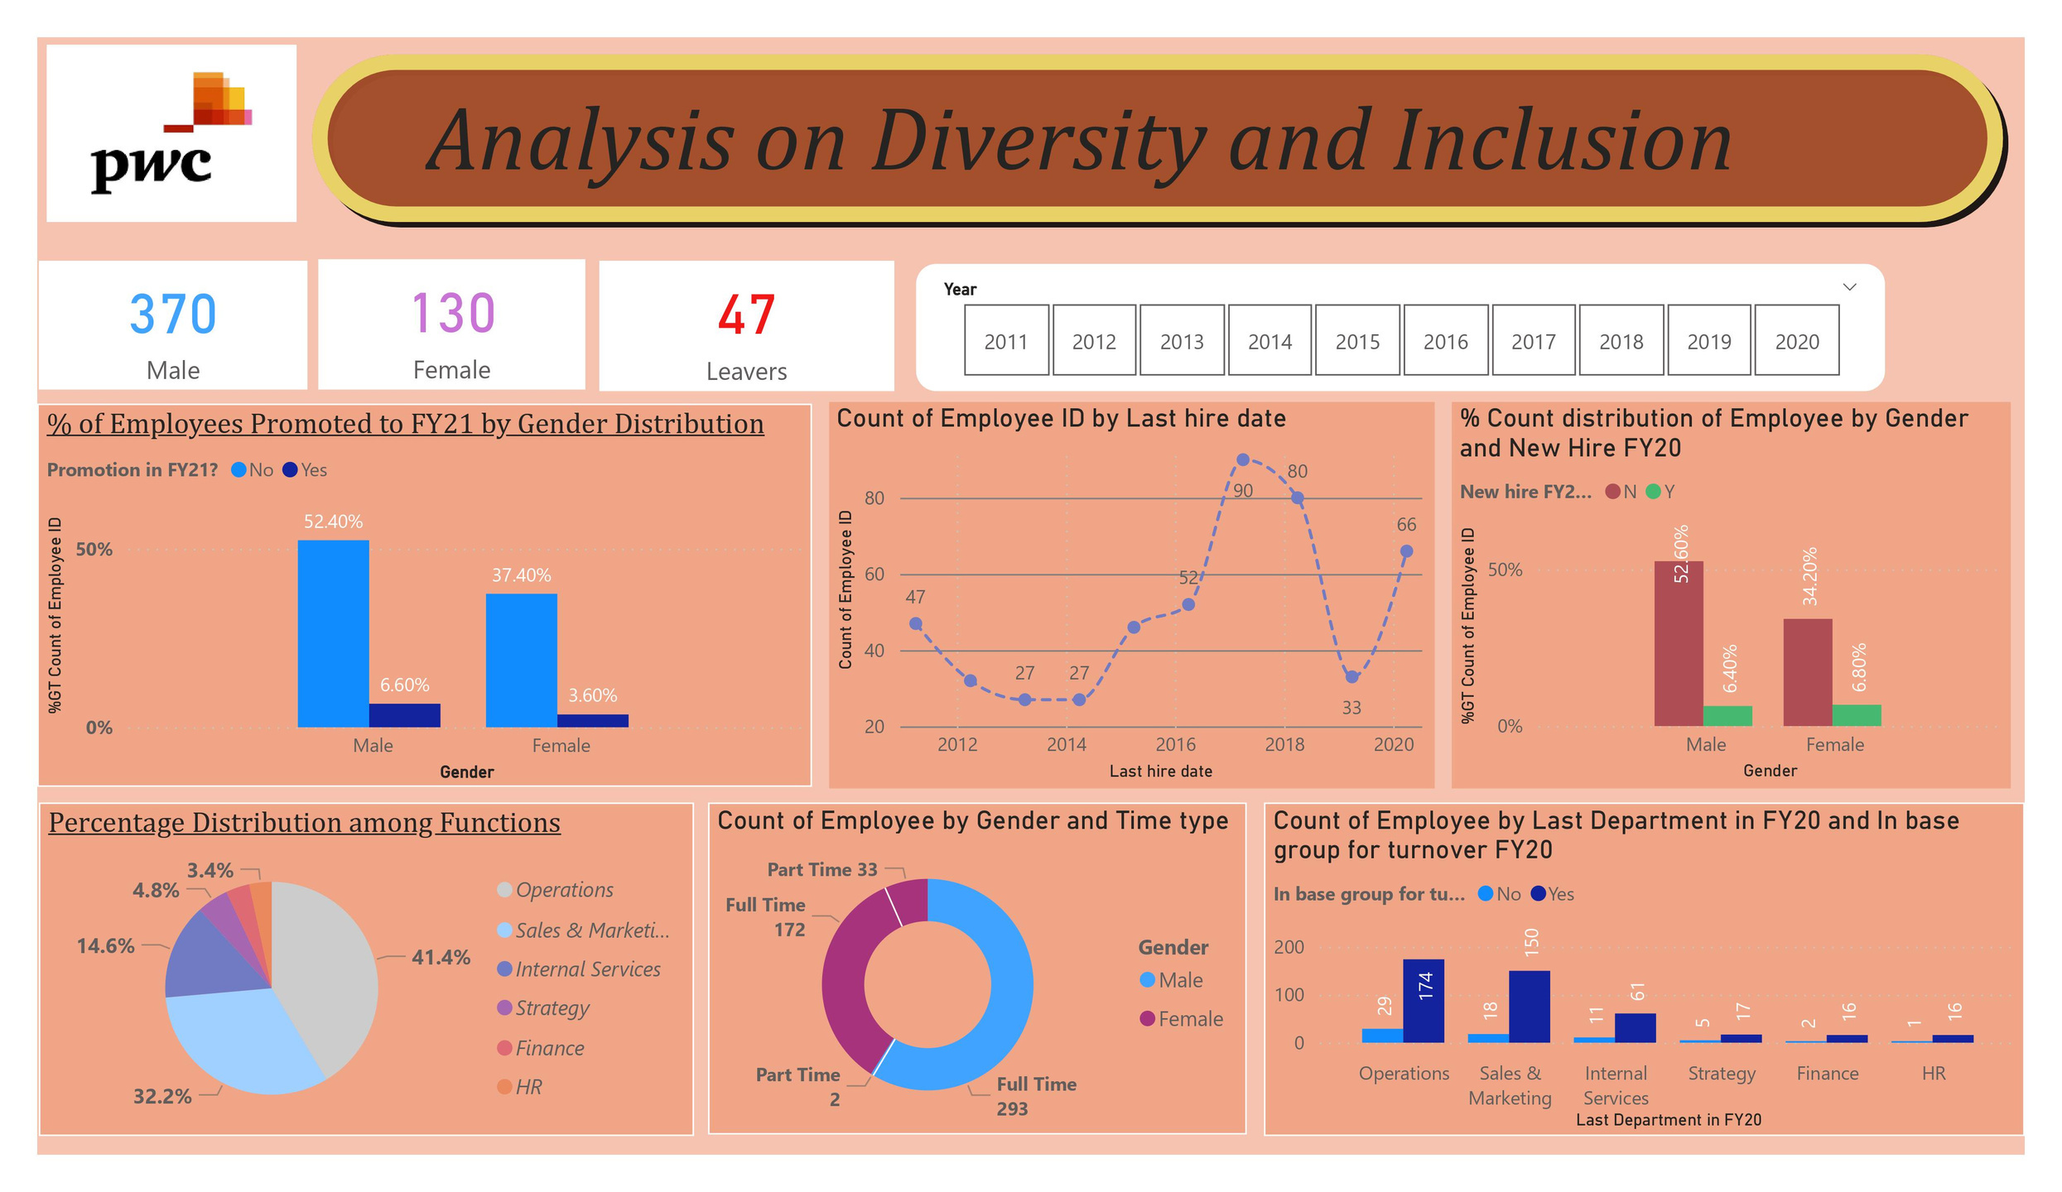

Slide 6
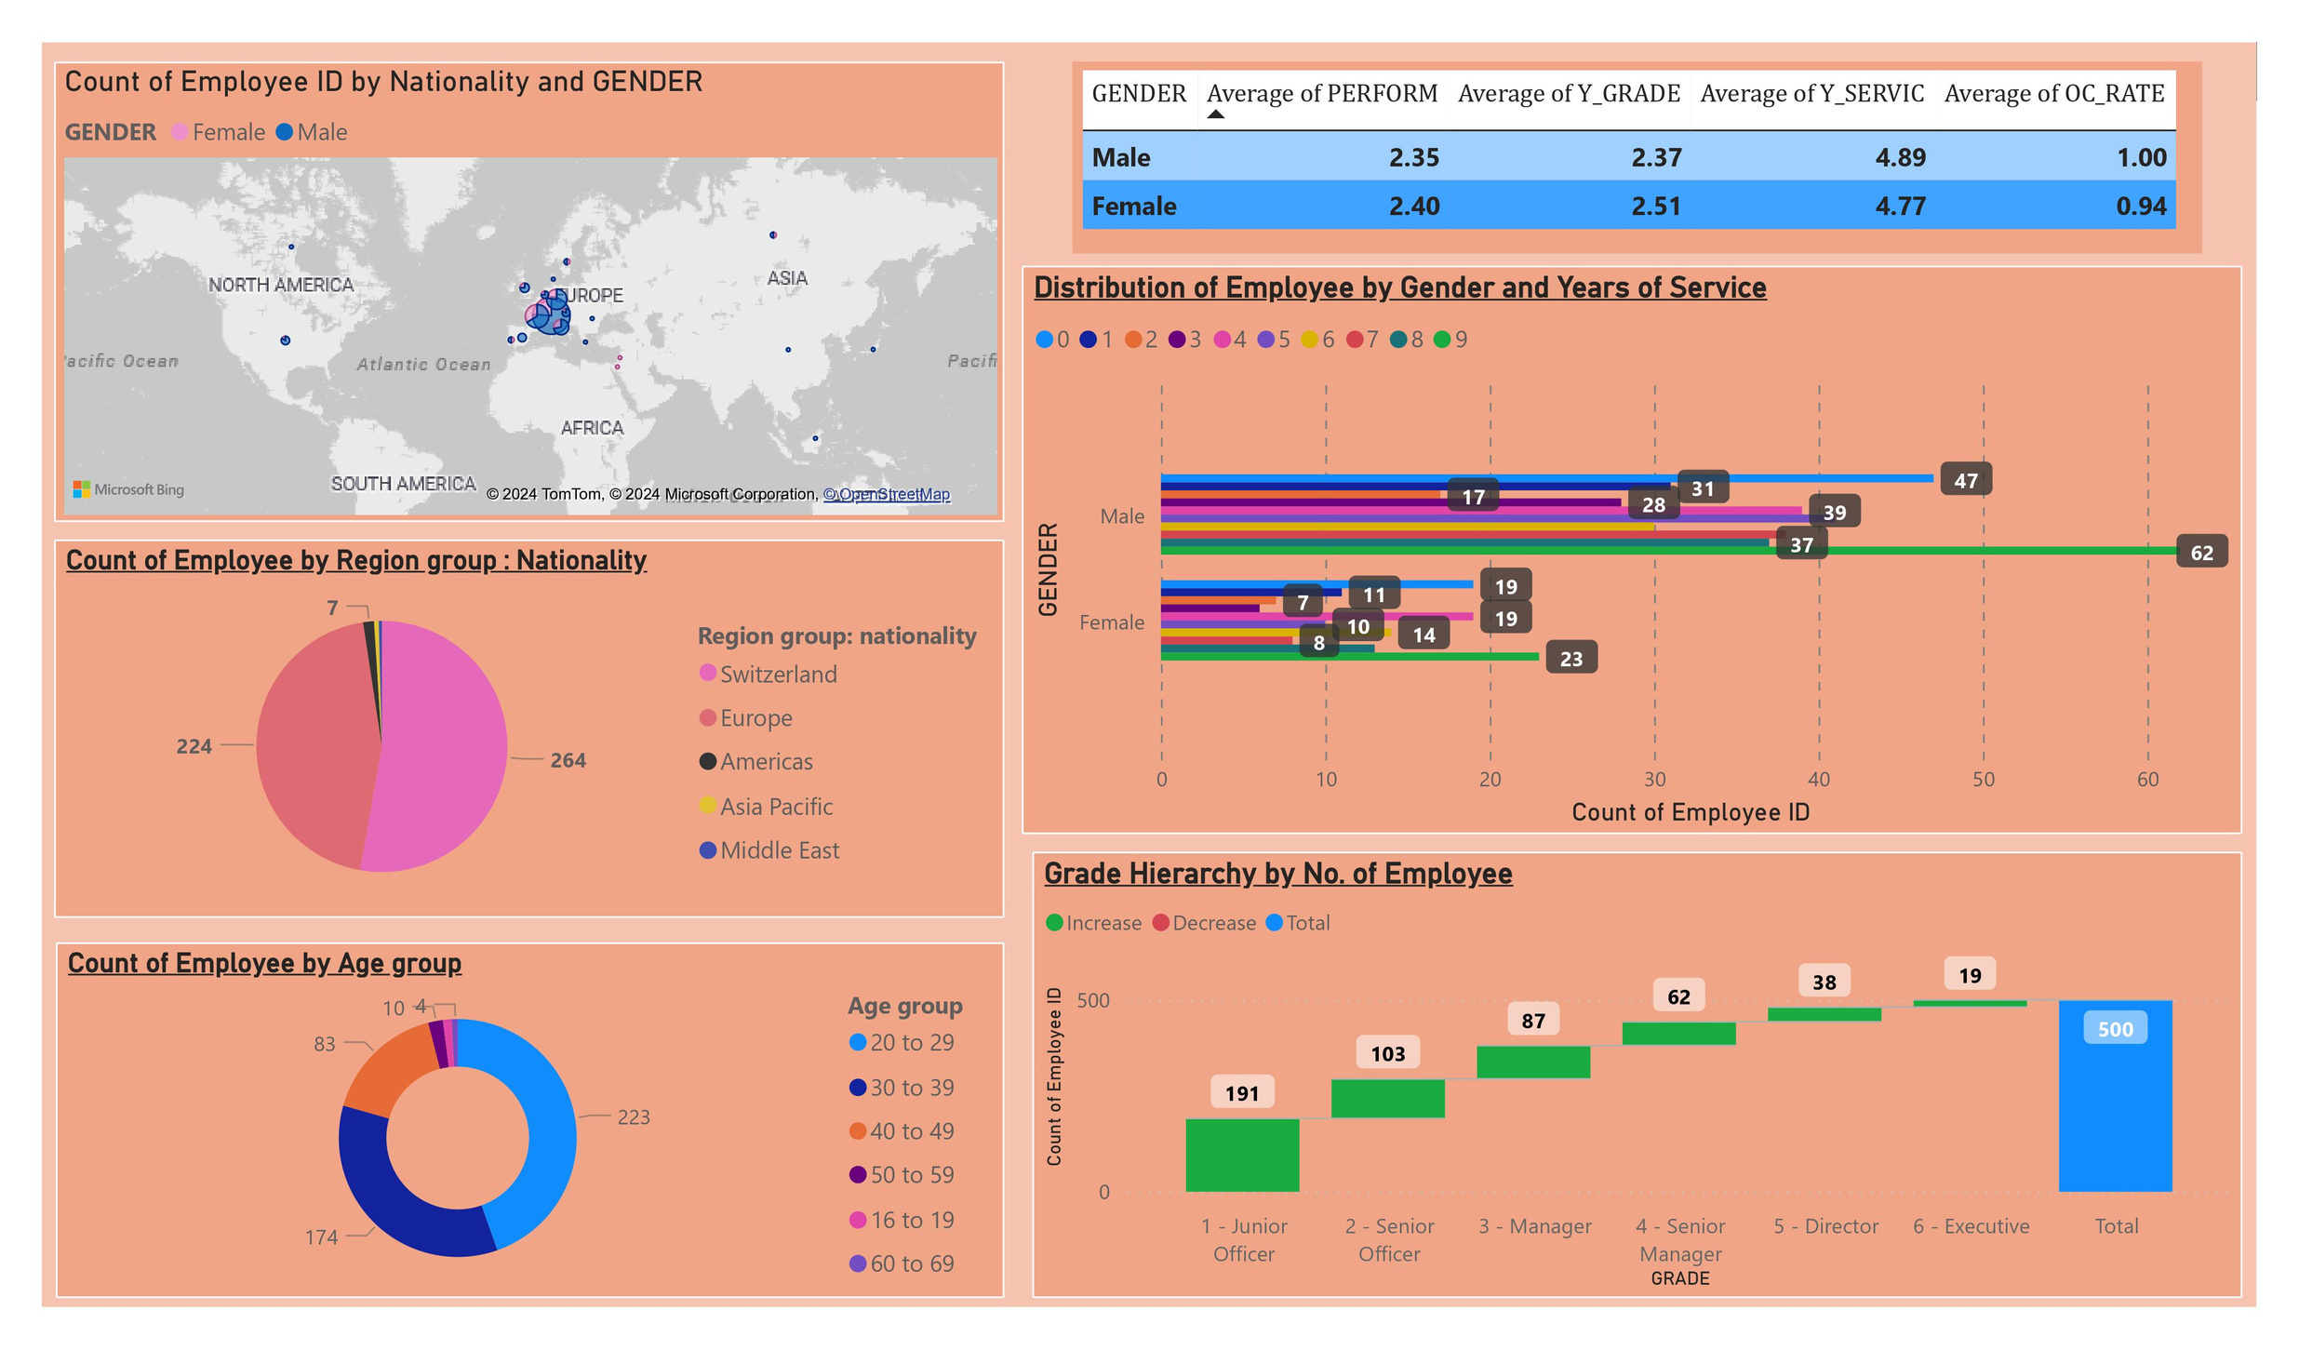

Slide 7

Conclusion
Through my analysis, I've uncovered areas for enhancing gender equity, retention strategies, and workforce diversity. These insights will shape actionable steps toward building a more inclusive organizational culture and supporting long-term growth.
~Thank You

